Slide 1
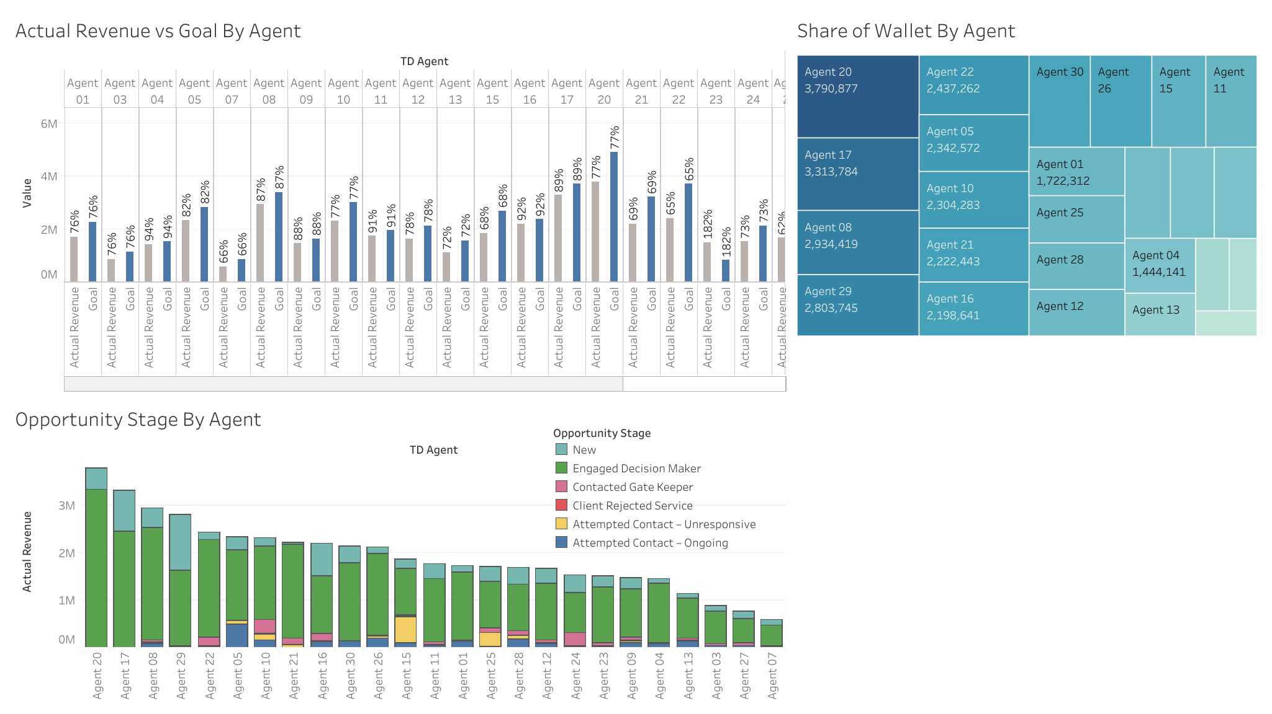
This dashboard show overall performance in each agent
Actual revenue VS Goal graph show percent achievement in each agent
Share of wallet show rank of agent
Opportunity stage graph show count of each stage
From the stage graph, we can conclude that the higher engaged decision maker, the higher actual revenue will gain

Slide 2
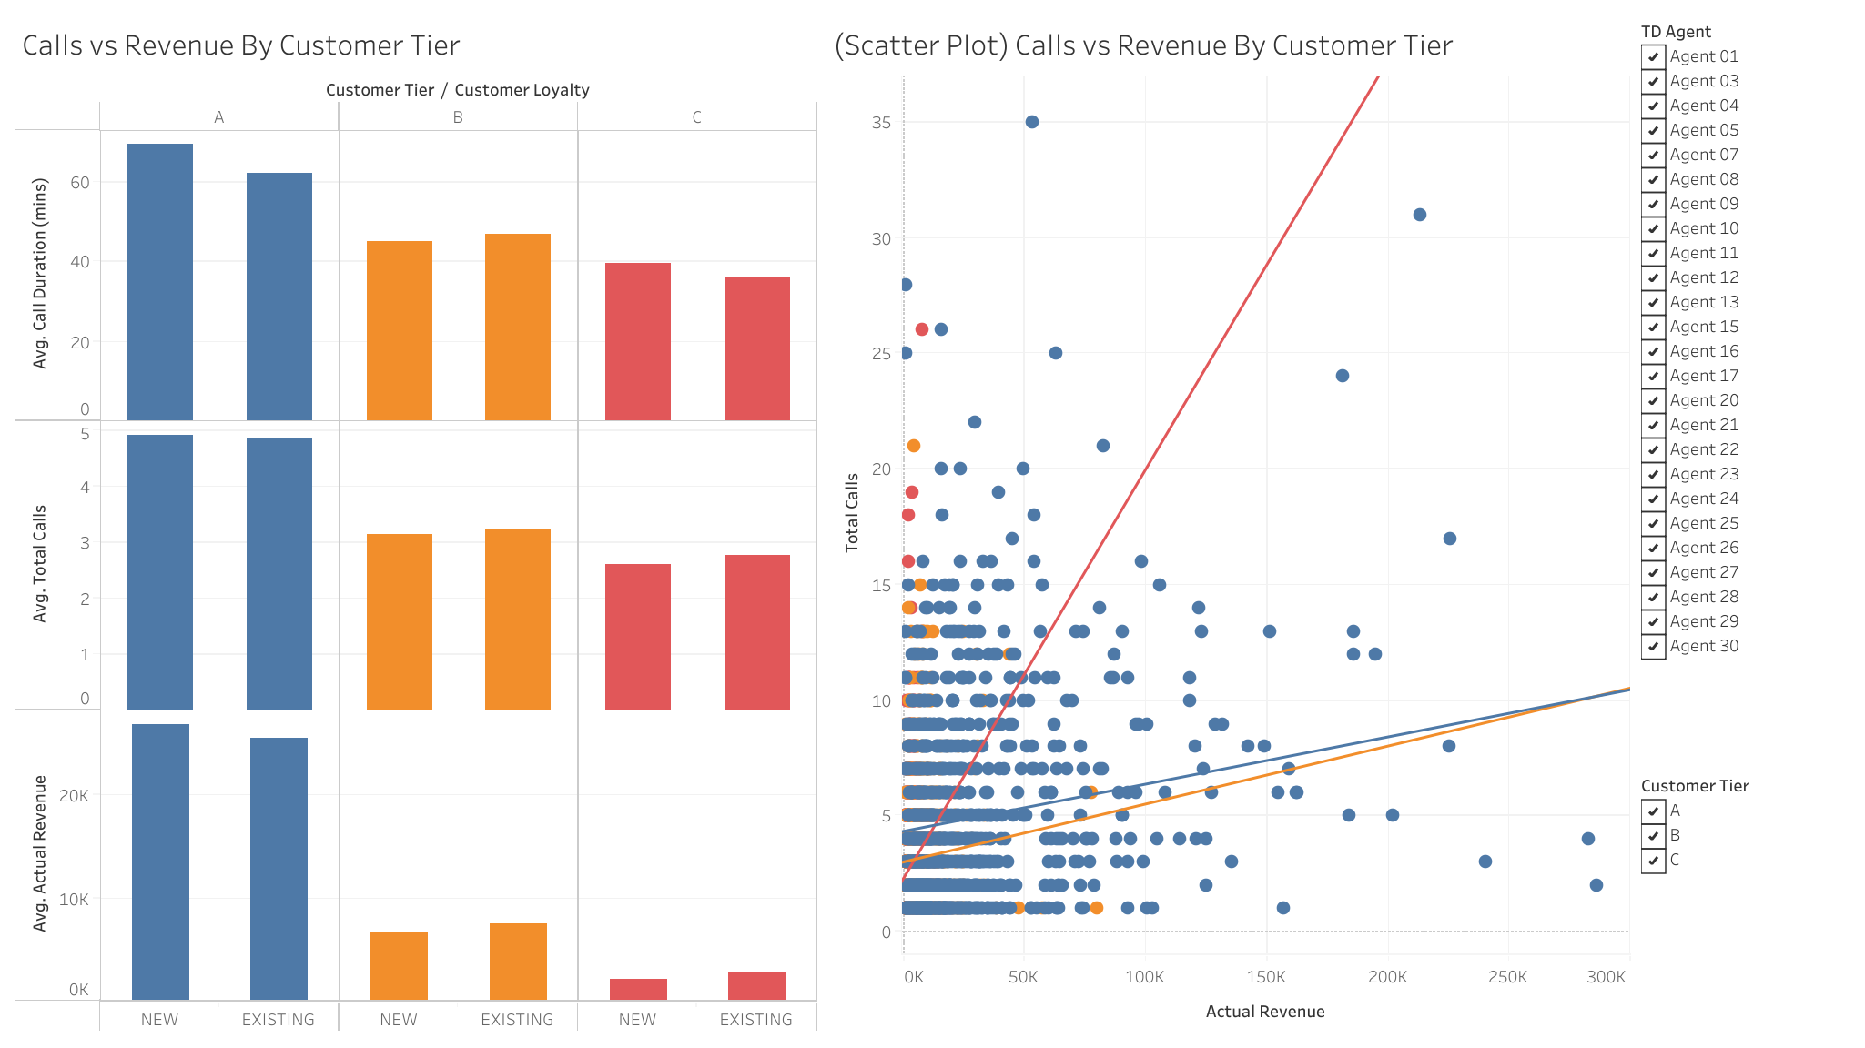
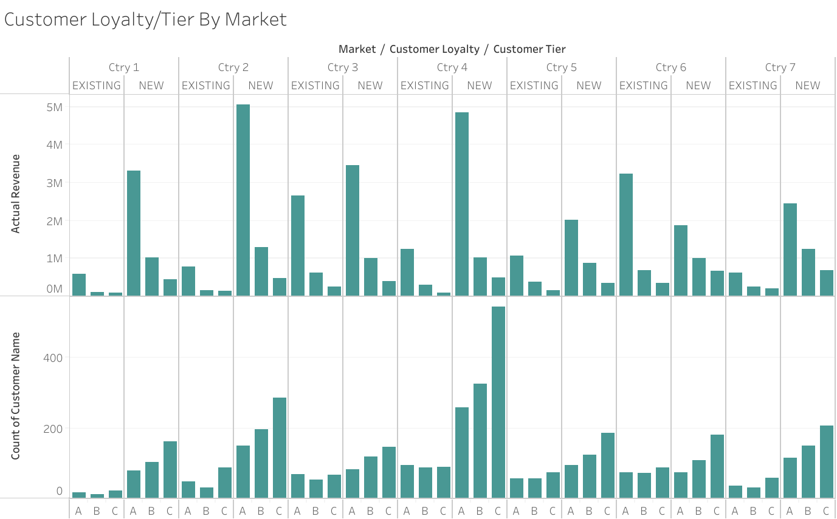
This dashboard show total calls, call duration separate by customer tier and customer loyalty
Bar graph show that actual revenue ,total calls and call duration is relate to customer tier
Scatter plot graph show correlation between total calls and actual revenue. Customer tier A is use less total call to gain more revenue.
This graph show actual revenue separate by market, customer tier and customer loyalty
above graph show that new customer will provide higher revenue
Below graph show that most of new customer is a customer tier C. So, we should find new customer that be in tier A to gain more revenue

Slide 3
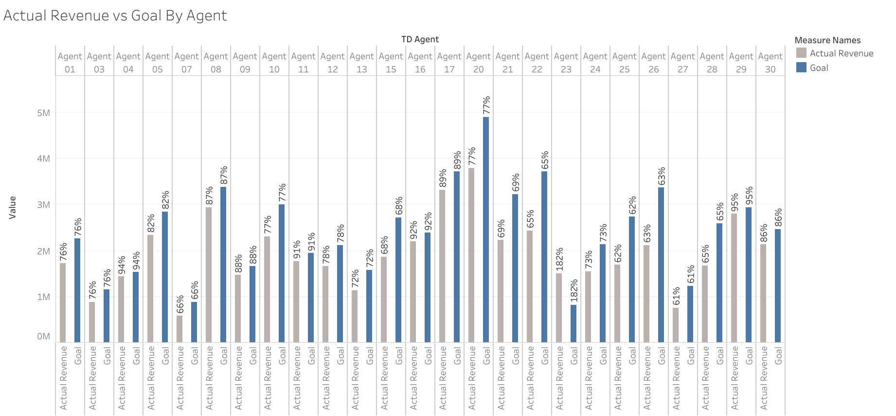

Slide 4
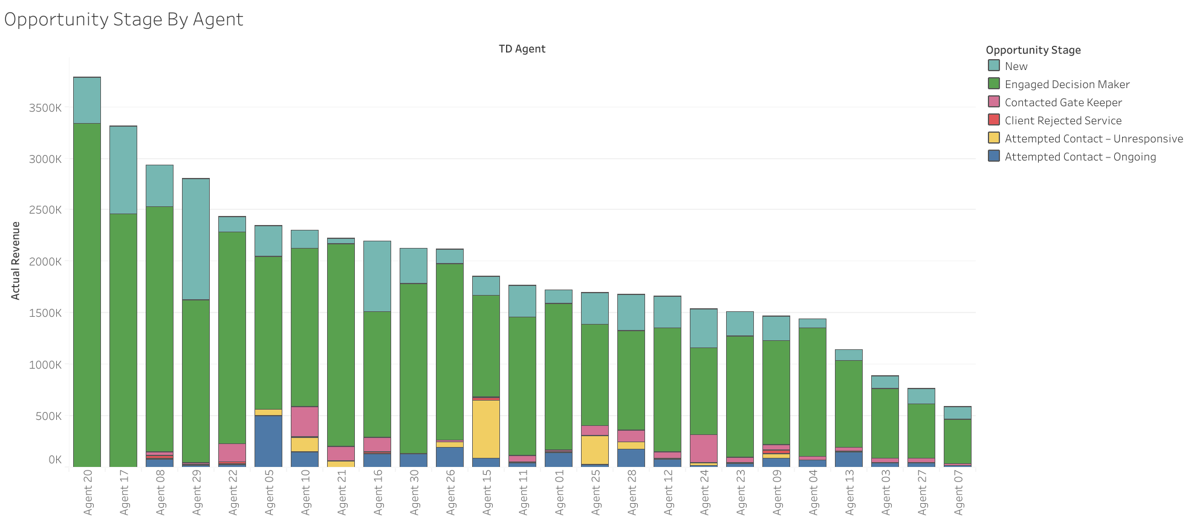

Slide 5
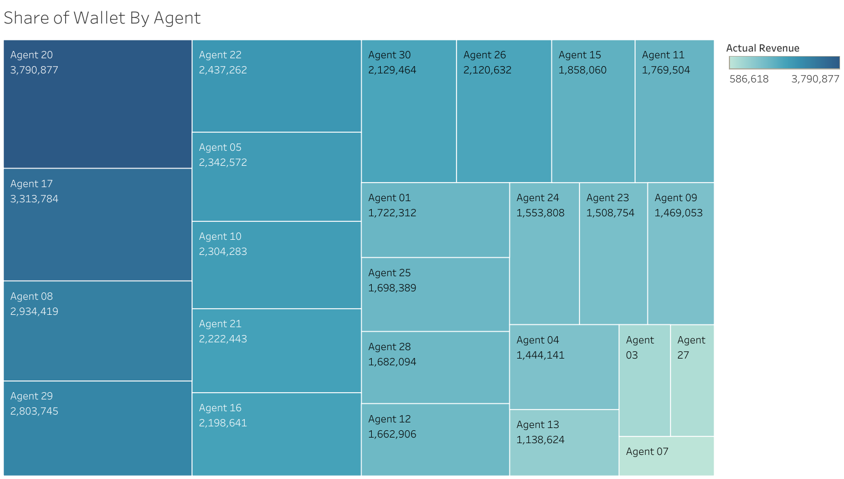

Slide 6
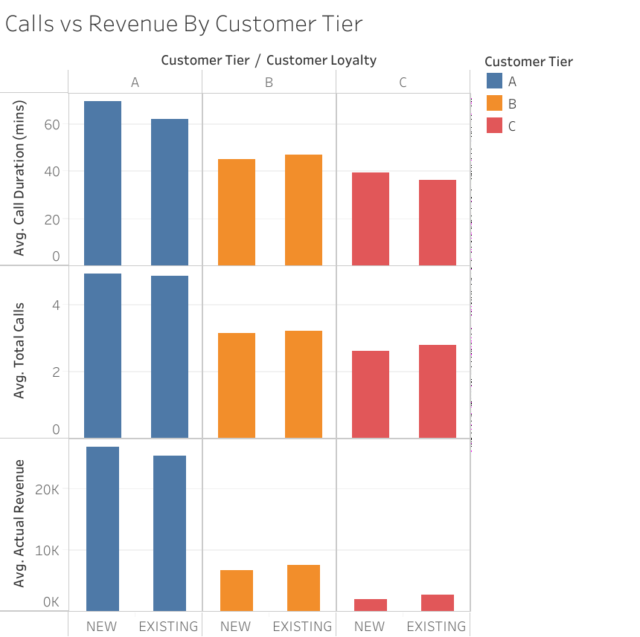

Slide 7
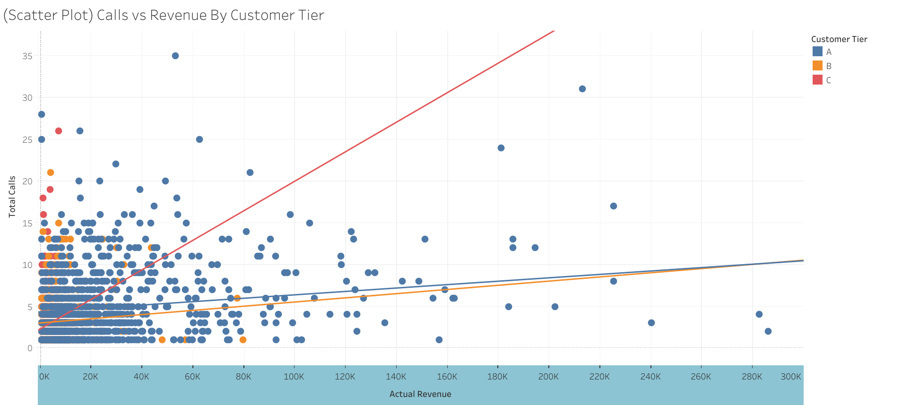

Slide 9
